Slide 1


Murali Kalva
02JAN2023

Slide 2

Outline
Executive Summary
Introduction
Methodology
Results
Conclusion
Appendix

Slide 3
Executive Summary
Summary of methodologies
Data Collection through API
Data Collection with Web Scraping
Data Wrangling
Exploratory Data Analysis with SQL
Exploratory Data Analysis with Data Visualization
Interactive Visual Analytics with Folium
Interactive Dashboard with Ploty Dash
Machine Learning Prediction
Summary of all results
Exploratory Data Analysis result
Interactive analytics in screenshots
Predictive Analytics result

Slide 4
Introduction
Project background and context
SpaceX advertises Falcon 9 rocket launches on its website with a cost of 62 million dollars other providers cost upwards of 165 million dollars each much of the savings is because SpaceX can reuse the first stage. Therefore, if we can determine if the first stage will land, we can determine the cost of a launch. Instead of using rocket science to determine if the first stage will land successfully, we will train a machine learning model and use public information to predict if SpaceX will reuse the first stage.
Problems you want to find answers
Factors effecting successful landing and to predict if SpaceX will reuse the first stage

Slide 5

Section 1

Slide 6
Methodology
Executive Summary
Data collection methodology:
SpaceX launch data that is gathered from an API, specifically the SpaceX REST API. This API will give us data about launches, including information about the rocket used, payload delivered, launch specifications, landing specifications, and landing outcome. Another popular data source for obtaining Falcon 9 Launch data is web scraping related Wiki pages
Perform data wrangling
using the Python BeautifulSoup package to web scrape some HTML tables that contain valuable Falcon 9 launch records.
Dealing with Nulls
filter/sample the data to remove Falcon 1 launches
Perform exploratory data analysis (EDA) using visualization and SQL
Perform interactive visual analytics using Folium and Plotly Dash
Perform predictive analysis using classification models
How to build, tune, evaluate classification models

Slide 7
Data Collection
Data Collection API
Data Collection with Web Scraping

Slide 8
Data Collection – SpaceX API
requesting rocket launch data from SpaceX API with the following URL: spacex_url="https://api.spacexdata.com/v4/launches/past"
Request and parse the SpaceX launch data using the GET request
decode the response content as a Json using and turn it into a Pandas dataframe
Filter the dataframe to only include Falcon 9 launches
Replace Missing Values with mean
GitHub URL testrepo/Data Collection API.ipynb at master · murali170717/testrepo (github.com)

Slide 9
Data Collection - Scraping
Request the Falcon9 Launch Wiki page from its URL: "https://en.wikipedia.org/w/index.php?title=List_of_Falcon_9_and_Falcon_Heavy_launches&oldid=1027686922"
Create a object from the HTML
Extract all column/variable names from the HTML table header
Create a data frame by parsing the launch HTML tables
GitHub URL testrepo/Data Collection with Web Scraping.ipynb at master · murali170717/testrepo (github.com)

Slide 10
Data Wrangling
Use the method on the column to determine the number of launches on each site
Use the method to determine the number and occurrence of each orbit in the column
Use the method on the column to determine the number of
Using the , create a list where the element is zero if the corresponding row in is in the set ; otherwise, it's one
GitHub URL testrepo/Data Wrangling.ipynb at master · murali170717/testrepo (github.com)

Slide 11
EDA with Data Visualization
charts were plotted
Flight Number vs. Payload Mass, Flight Number vs. Launch Site, Payload Mass vs. Launch Site, Orbit Type vs. Success Rate, Flight Number vs. Orbit Type, Payload Mass vs Orbit Type and Success Rate Yearly Trend
Scatter plots show the relationship between continuous variables and Bar charts show comparisons among categorical variables.
GitHub URL testrepo/EDA with Data Visualization.ipynb at master · murali170717/testrepo (github.com)
GitHub URL testrepo/EDA with Data Visualization.ipynb at master · murali170717/testrepo (github.com)

Slide 12
EDA with SQL
names of the unique launch sites in the space mission
5 records where launch sites begin with the string 'CCA'
total payload mass carried by boosters launched by NASA (CRS)
average payload mass carried by booster version F9 v1.1
date when the first successful landing outcome in ground pad was acheived.
names of the boosters which have success in drone ship and have payload mass greater than 4000 but less than 6000
total number of successful and failure mission outcomes
names of the booster_versions which have carried the maximum payload mass. Use a subquery
failed landing_outcomes in drone ship, their booster versions, and launch site names for in year 2015
Ranking the count of landing outcomes (such as Failure (drone ship) or Success (ground pad)) between the date 2010-06-04 and 2017-03-20, in descending order
GitHub URL testrepo/EDA with SQL.ipynb at master · murali170717/testrepo (github.com)

Slide 13
Build an Interactive Map with Folium
Added Marker with Circle, Popup Label and Text Label of NASA Johnson Space Center using its latitude and longitude coordinates as a start location. - Added Markers with Circle, Popup Label and Text Label of all Launch Sites using their latitude and longitude coordinates to show their geographical locations and proximity to Equator and coasts.
Added coloured Markers of success (Green) and failed (Red) launches using Marker Cluster to identify which launch sites have relatively high success rates.
Added coloured Lines to show distances between the Launch Site KSC LC-39A (as an example) and its proximities like Railway, Highway, Coastline and Closest City.
GitHub URL: testrepo/Interactive Visual Analytics with Folium.ipynb at master · murali170717/testrepo (github.com)

Slide 14
Which F9 Booster version (v1.0, v1.1, FT, B4, B5, etc.) has the highest
launch success rate
Build a Dashboard with Plotly Dash
Launch Site Drop-down Input Component: to select launch site
Callback function to render success-pie-chart based on selected site dropdown: to know site has the largest successful launches and site has the highest launch success rate
Range slider to select payload: to know Which payload range(s) has the highest and lowest launch success rate
Callback function to render success-payload-scatter-chart scatter plot: to know which F9 Booster version has the highest launch success rate
GitHub URL testrepo/Dashboard_with_Ploty_Dash.py at master · murali170717/testrepo (github.com)

Slide 15
Predictive Analysis (Classification)
GitHub URL testrepo/Machine Learning Prediction.ipynb at master · murali170717/testrepo (github.com)
Create a NumPy array from the column in data, by applying the method to_numpy(_)
Use the function train_test_split to split the data X and Y into training and test data
Standardize the data then reassign it to the variable using the transform
Create a logistic regression object then create a GridSearchCV object with cv = 10
Calculate the accuracy on the test data using the method
Create a support vector machine object then create a object with cv - 10
Calculate the accuracy on the test data using the method score:
Create a decision tree classifier object then create a object with cv = 10
Calculate the accuracy of tree_cv on the test data using the method :
Create a k nearest neighbors object then create a object with cv = 10
Calculate the accuracy of tree_cv on the test data using the method
Find the method performs bes

Slide 16
Results
Exploratory data analysis results
Interactive analytics demo in screenshots
Predictive analysis results

Slide 17

Section 2

Slide 18
Flight Number vs. Launch Site
larger the flight numbers at a launch site, the greater the success rate at a launch site

Slide 19
Payload vs. Launch Site
higher the payload mass, the higher the success rate.

Slide 20
Success Rate vs. Orbit Type
Orbits ES-L1, GEO, HEO, SSO and 100% success rate and orbit SO has 0% success rate

Slide 21
Flight Number vs. Orbit Type
in the LEO orbit, success is related to the number of flights whereas in the GTO orbit, there is no relationship between flight number and the orbit

Slide 22
Payload vs. Orbit Type
As payload Mass increases, the successful landing are more for PO, LEO and ISS orbits

Slide 23
Launch Success Yearly Trend
From 2013 to 2020 there is increase in success rate

Slide 24
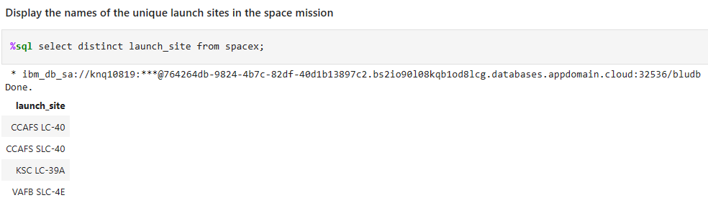
All Launch Site Names
Keyword distinct used to select unique launch sites

Slide 25
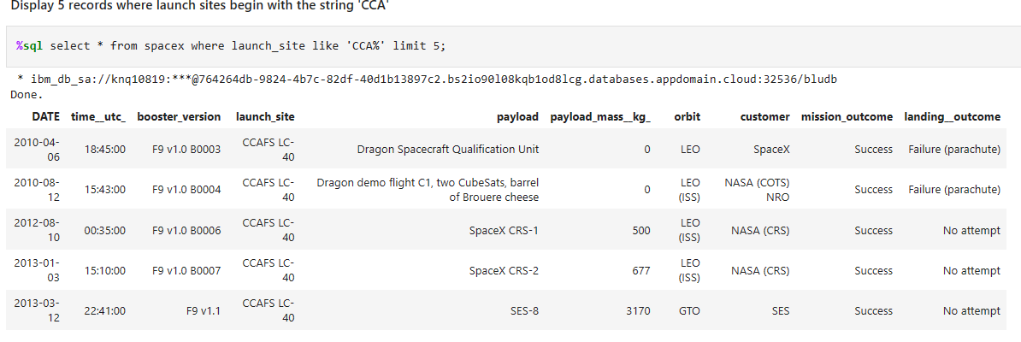
Launch Site Names Begin with 'CCA'
% is used along with limit 5 to display launch site Names that bedign with ‘CCA’

Slide 26
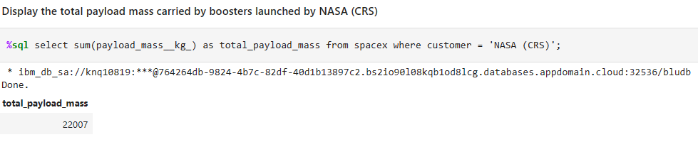
Total Payload Mass
Sum function along with where is used to to display payload mass by NASA(CRS)

Slide 27
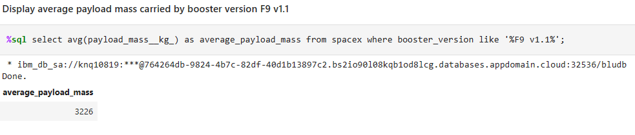
Average Payload Mass by F9 v1.1
Avg function along with % used to display average payload mass by F9 v1.1

Slide 28
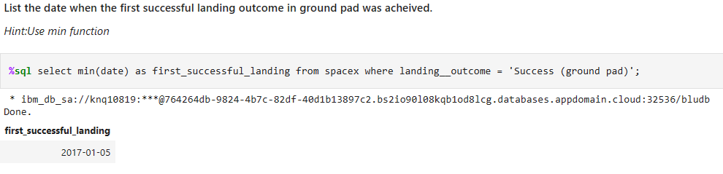
First Successful Ground Landing Date
Min function is used to display first successful ground landing date

Slide 29
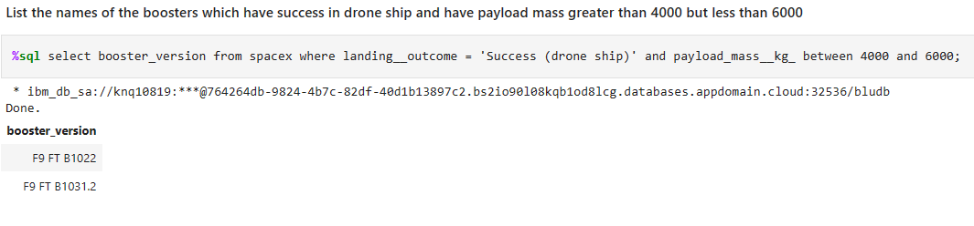
Successful Drone Ship Landing with Payload between 4000 and 6000
Where and between are used to display successful drone ship landing with payload between 4000 and 6000

Slide 30
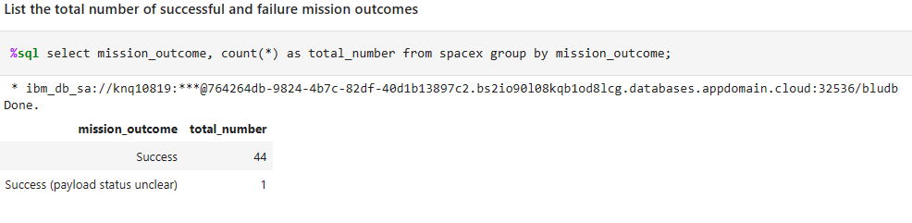
Total Number of Successful and Failure Mission Outcomes
Count is used to display total no.of successful and failure mission outsomes

Slide 31
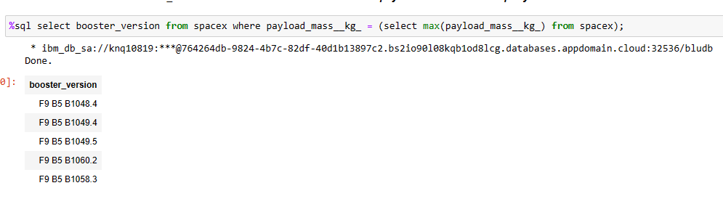
Boosters Carried Maximum Payload
Max function is used to display boosters carried maximum payload

Slide 32
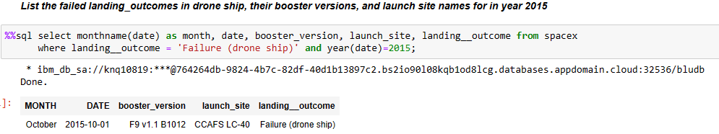
2015 Launch Records
Where and year function used to failed 2015 launch records

Slide 33
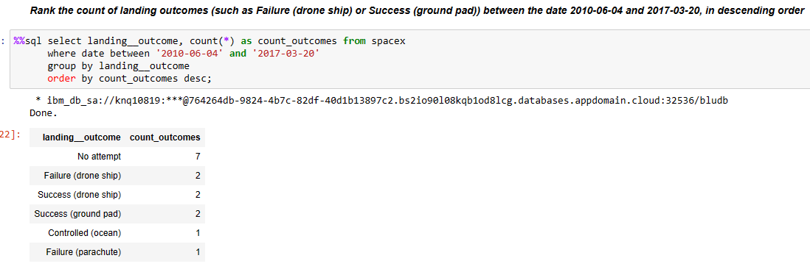
Rank Landing Outcomes Between 2010-06-04 and 2017-03-20
Between and desc in order is used to rank landing outcomes is descending order between 2010-06-04 and 2017-03-02

Slide 34

Section 3

Slide 35
All launch sites
We can see the launch sites are in USA coasts, California and Florida minimizes the risk of debris as they will fall in ocean

Slide 36
Markers showing launch sites
G
Green is successful launch and Red is failed launch

Slide 37
Distance from KSCLC-39A site to landmarks
From railway 15.23 km, from roadway 20.28 km, from coastline 14.99 km

Slide 38

Section 4

Slide 39
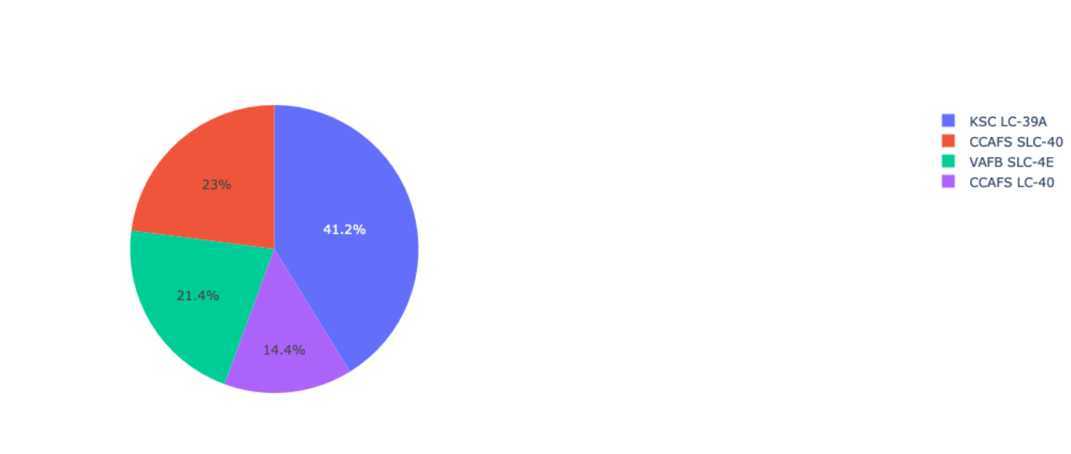
success by site using pie chart
KSC LC-39A has highest success percentage

Slide 40
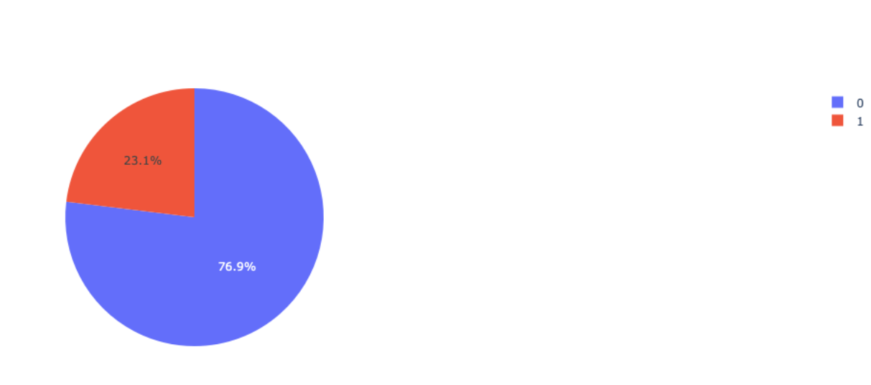
KSC LC-39A Success Ratio: Pie chart
Success percentage is 76.9% and failure percentage is 23.1%

Slide 41
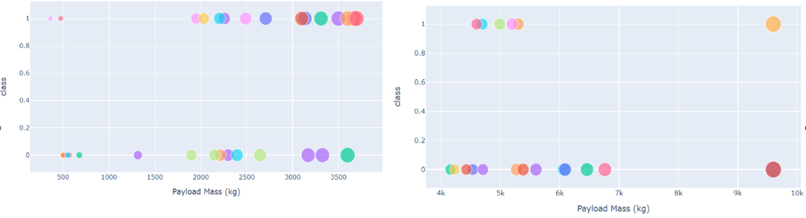
Payload vs Launch Outcome
Replace <Dashboard screenshot 3> title with an appropriate title
Show screenshots of Payload vs. Launch Outcome scatter plot for all sites, with different payload selected in the range slider
Explain the important elements and findings on the screenshot, such as which payload range or booster version have the largest success rate, etc.
Low weight payloads (left) has higher success than high weight payload (right)

Slide 42

Section 5

Slide 43
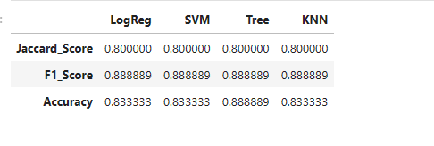
Classification Accuracy
From the above scores based on complete dataset, Decision model has highest accuracy and higher scores and is the best model

Slide 44
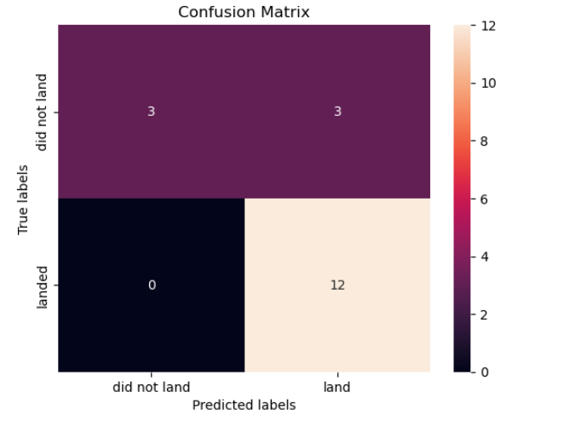
Confusion Matrix
From the above matrix we can see false positives

Slide 45
Conclusions
larger the flight numbers at a launch site, the greater the success rate at a launch site
higher the payload mass, the higher the success rate
From 2013 to 2020 there is increase in success rate
KSC LC-39A site has highest success percentage
Low weight payloads has higher success than high weight payload
Decision model has highest accuracy and higher scores and is the best model

Slide 46


